Slide 1
Employee Data Analysis using Excel
STUDENT NAME:NIVEDHA SHYLA .A
REGISTER NO: 312216384 (asunm1621312216384)
DEPARTMENT: BCOM. COMPUTER APPLICATIONS
COLLEGE : SHRI SHANKARLAL SUNDARBAI SHASUN JAIN COLLEGE
FOR WOMEN

Slide 2
PROJECT TITLE
Employee Performance Analysis using Excel

Slide 3


AGENDA
Problem Statement
Project Overview
End Users
Our Solution and Proposition
Dataset Description
Modelling Approach
Results and Discussion
Conclusion
3/21/2024 Annual Review

Slide 4

PROBLEM STATEMENT In our organization, employee performance is critical to achieving strategic goals and maintaining competitive advantage. Despite having performance metrics and review processes in place, we are experiencing inconsistent results in employee productivity and overall engagement.

Slide 5

PROJECT OVERVIEW
. Identify Performance Gaps: Determine discrepancies in performance levels among employees.
Analyze Root Causes: Understand the underlying factors contributing to performance issues.
Develop Action Plans: Create targeted interventions to address performance gaps.
Enhance Overall Performance: Implement strategies to improve productivity, employee engagement, and reduce turnover.

Slide 6

Who are the end users?
Managers and Supervisors
Human Resources (HR) Department
Executives and Senior Leadership
Employees
Training and Development Teams
Project Teams
Organizational Development Specialists
Compensation and Benefits Teams
Compliance and Audit Teams
External Consultants

Slide 7

OUR SOLUTION AND ITS VALUE PROPOSITION Conditional formatting – missing Filter-remove Formula – performance Pivot-summary Graph – data visualization

Slide 8
Dataset Description Employee = Kaggle 26-features 9-features emp id-num Name-text EMP type Performance level Gender- male , female Employee rating-num

Slide 9

THE "WOW" IN OUR SOLUTION
Performance level= IFS(Z8>=5,”VERY HIGH”,
Z8>=4,”HIGH”,Z8>=3,”MED”,TRUE,”LOW”)
3/21/2024 Annual Review
9

Slide 10
MODELLING
Data collection:
From kaggle
Feature collection:
Data cleaning:
Performance level:
Visulaization:
Summary:
Relevance: Identify features that directly impact performance, such as task completion rates, quality of work, and adherence to deadlines.
Standardization: Define and standardize performance features to ensure consistency in data analysis.
Measurement: Develop clear metrics for each feature (e.g., number of completed projects, customer satisfaction scores).
Categories: Group features into categories such as productivity, quality, and behavior for more comprehensive analysis.
Documentation: Keep detailed records of each feature’s definition, source, and method of measurement.
Error Correction: Identify and correct errors in the data, such as incorrect entries or miscalculations.
Consistency Checks: Ensure that data formats and values are consistent across different sources (e.g., standard units of measurement).
Handling Missing Data: Address missing data by using techniques like imputation or follow-up data collection.
Criteria Definition: Clearly define performance levels (e.g., exceeds expectations, meets expectations, below expectations) based on established benchmarks.
Scoring System: Implement a scoring or rating system to objectively categorize performance.
Types of Visuals: Use bar charts, line graphs, pie charts, heatmaps, and dashboards to represent performance data visually.
Clarity: Design visuals that clearly convey the data and insights, using appropriate labels, legends, and color schemes.
Tools: Utilize visualization tools like Excel, Tableau, or Power BI to create effective graphical representations.
Key Insights: Summarize major findings from the performance analysis, including strengths, weaknesses, and areas needing improvement.
Trends: Highlight significant trends or patterns observed across employees or teams.
Recommendations: Offer actionable recommendations based on the analysis to address performance issues or leverage strengths.
10

Slide 11
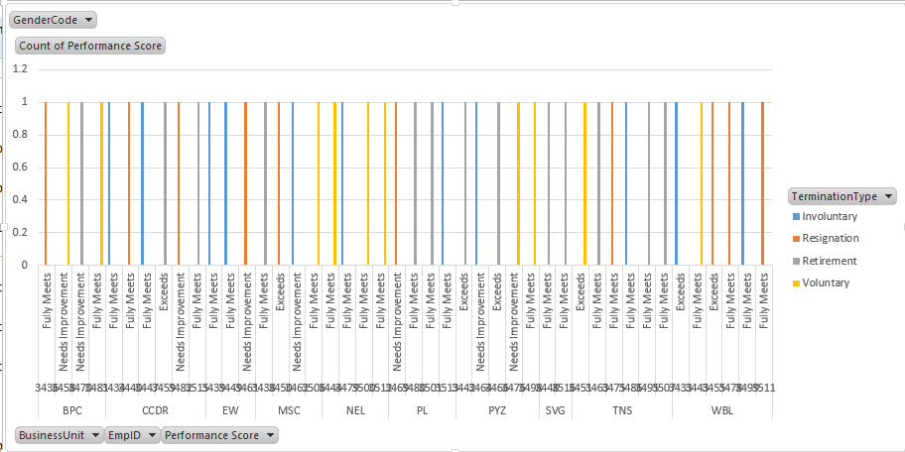
RESULTS
11

Slide 12
Conclusion The employee performance analysis conducted over the past [time period] has provided valuable insights into the current state of employee performance across the organization. Key findings include: Performance Distribution: A clear distribution of performance levels was observed, with [percentage] of employees exceeding expectations, [percentage] meeting expectations, and [percentage] falling below expectations. Strengths Identified: Employees excelled in areas such as [specific strengths, e.g., productivity, client satisfaction], contributing positively to organizational goalsAreas for Improvement: Notable areas for improvement include [specific weaknesses, e.g., adherence to deadlinesteamwork]. These areas have been consistently highlighted across multiple departments. Trends and Patterns: Analysis revealed [specific trends or patterns, e.g., higher performance in certain teams or departments, seasonal variations in performance The insights gained from this performance analysis are instrumental in shaping our approach to employee development and organizational success. By implementing the recommended strategies and focusing on continuous improvement, we can enhance overall performance, boost employee satisfaction, and achieve our strategic objectives. We encourage all stakeholders to actively engage with the findings and contribute to the ongoing efforts to drive performance excellence across the organization.

